Slide 1
ATM Application Using Tkinter and MySQL
Title: ATM Transaction Management System
Subtitle: Using SQL, Tkinter, and Python Name: Shifana.A

Slide 2
Objective of the ATM Application
The objective of this ATM application is to provide a simple yet functional system for managing user accounts, transactions, and balances, simulating an ATM interface. It allows users to securely log in, perform transactions like deposits and withdrawals, check their balance, and view transaction history—all through a graphical user interface (GUI) powered by Tkinter. The system interacts with a MySQL database to store and manage user data, ensuring data persistence and security (via PIN hashing).

Slide 3
Key goals include:
Secure Login: Users log in with their account number and PIN, with the PIN being securely hashed to protect sensitive information.
Transaction Handling: Users can deposit and withdraw money, with all transactions recorded in the system for historical tracking.
Balance Inquiry: Users can check their account balance at any time.
Transaction History: Users can view a detailed history of their past transactions, including type, amount, and date.
Account Registration: New users can register by creating an account with an initial balance, securely storing their PIN.
Database Interaction: All user and transaction data is stored in a MySQL database, ensuring persistence and integrity.

Slide 4
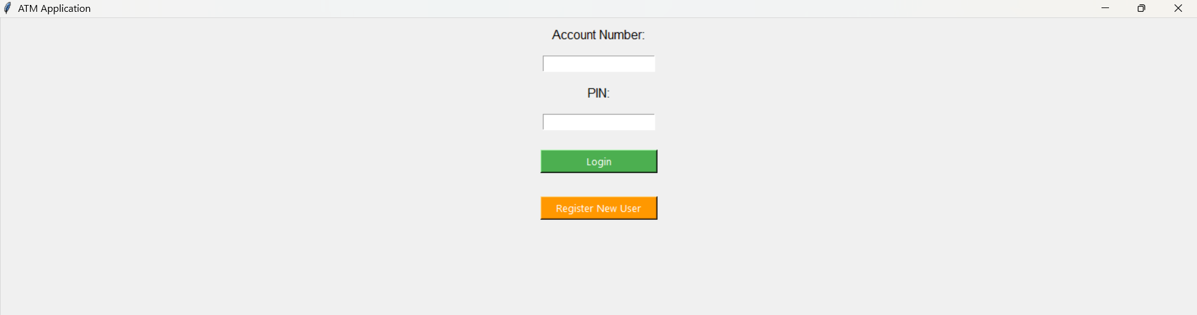
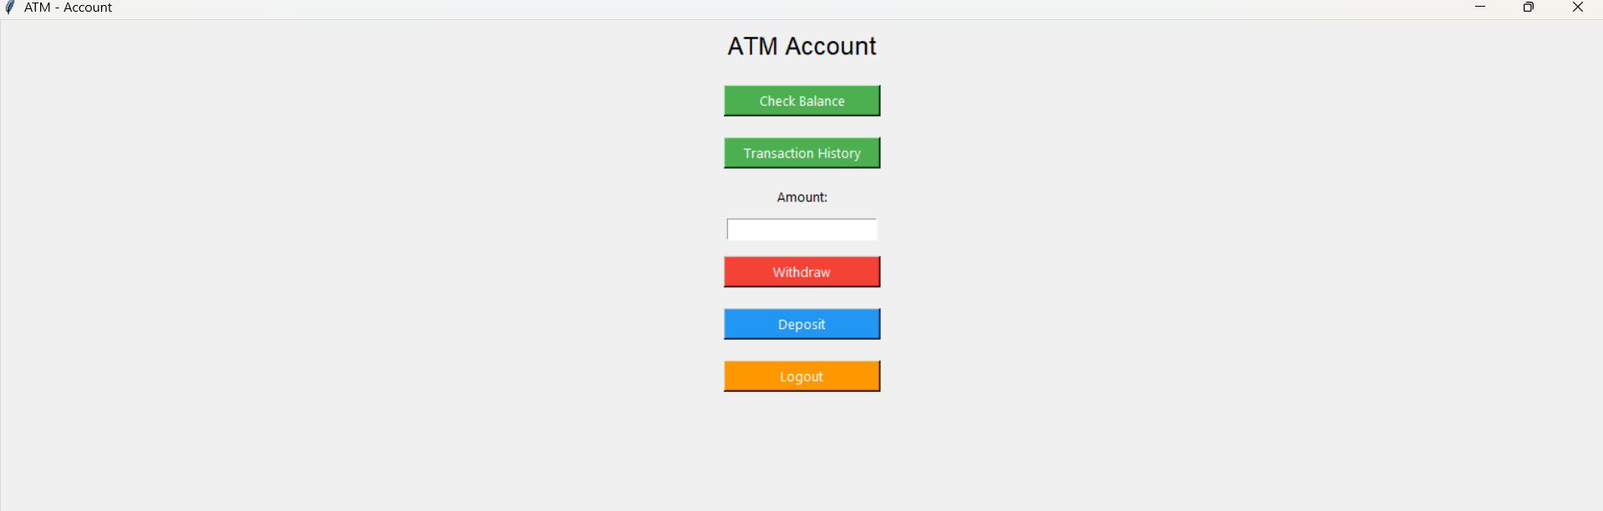

Slide 5
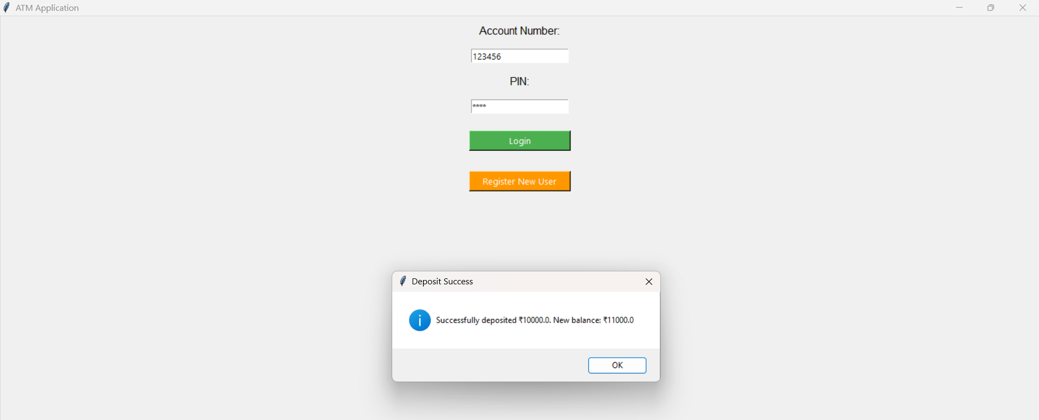

Slide 6
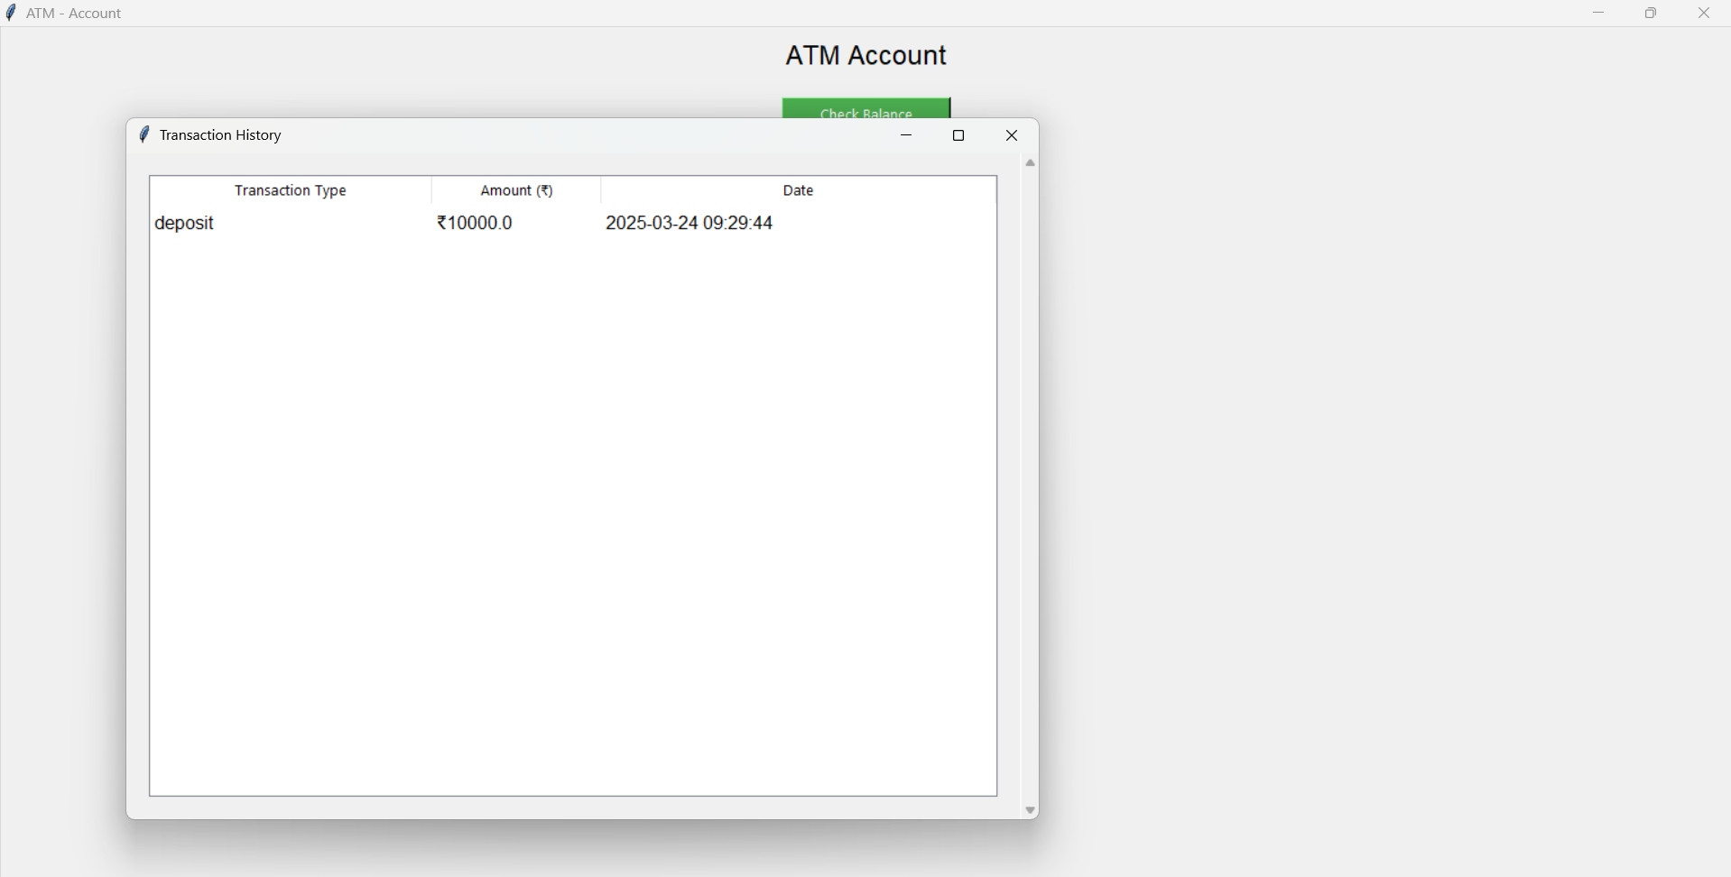

Slide 7

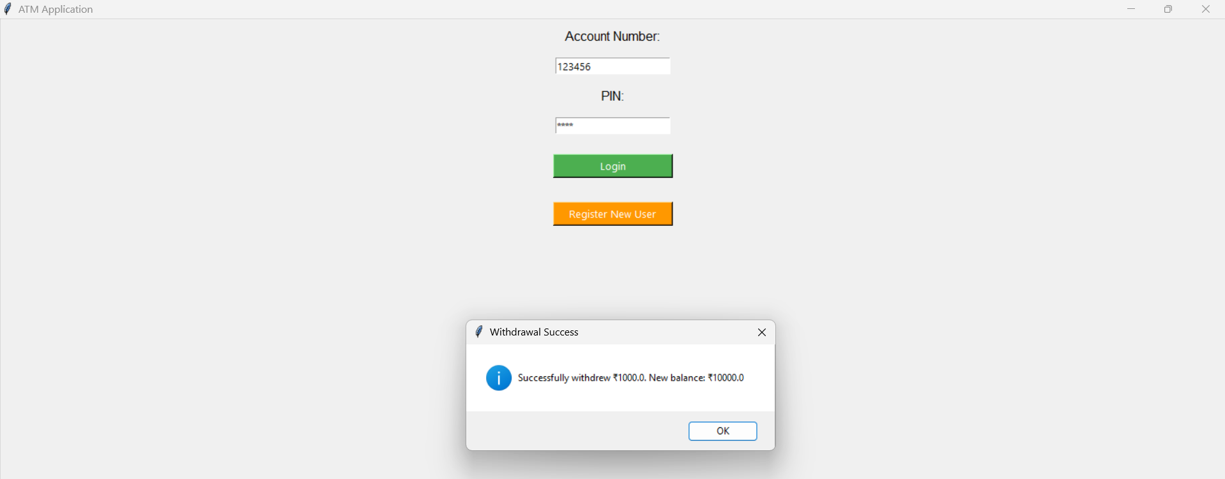

Slide 8
Conclusion
Outcome: A fully functional ATM simulation with secure user login, balance management, and transaction history tracking.
Future Enhancements:
Integrating a more advanced security system (e.g., two-factor authentication).
Adding features like fund transfer between accounts.

